Slide 1

Machine Learning on Used Phone Price Predictions
Name : BADAVATH SRIKANTH Reg. No.: 12019441
Course Code: INT355 Section: K20KT

Slide 2
Table of contents
02
04
01
Visualisation
03
Accurate ML Model
Introduction
Building Machine Learning Models
06
05
Conclusion
Final Inference
Performing Data Cleaning, Analysis
That suits the Dataset
Comparison
Ml models comparision
What is the Dataset about? (Domain)

Slide 3
Introduction
01
Used Phone Price Prediction aims to predict the price of used phones based on their features using machine learning. The dataset contains various attributes such as brand, model, display size, processor type, RAM, storage type, graphics card, weight, and price. By training our models on this data, we can determine the most significant features impacting the price of a used phone. Our objective is to provide insights that can inform pricing strategies for phone resellers and online marketplaces..
ELECTRONICS DOMAIN
This dataset belongs to the domain of Electronics. Electronics domain deals with the design, development, manufacturing, and maintenance of various electronic devices.

Slide 4
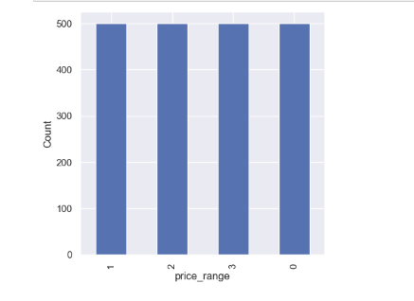
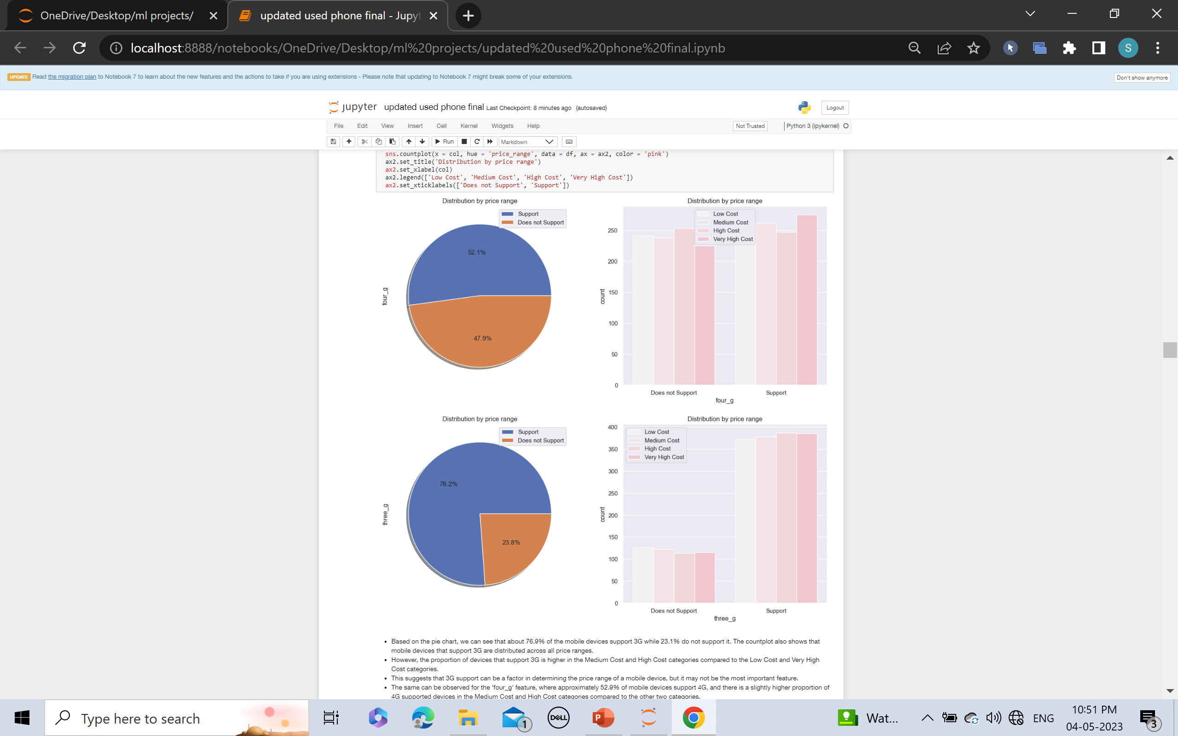
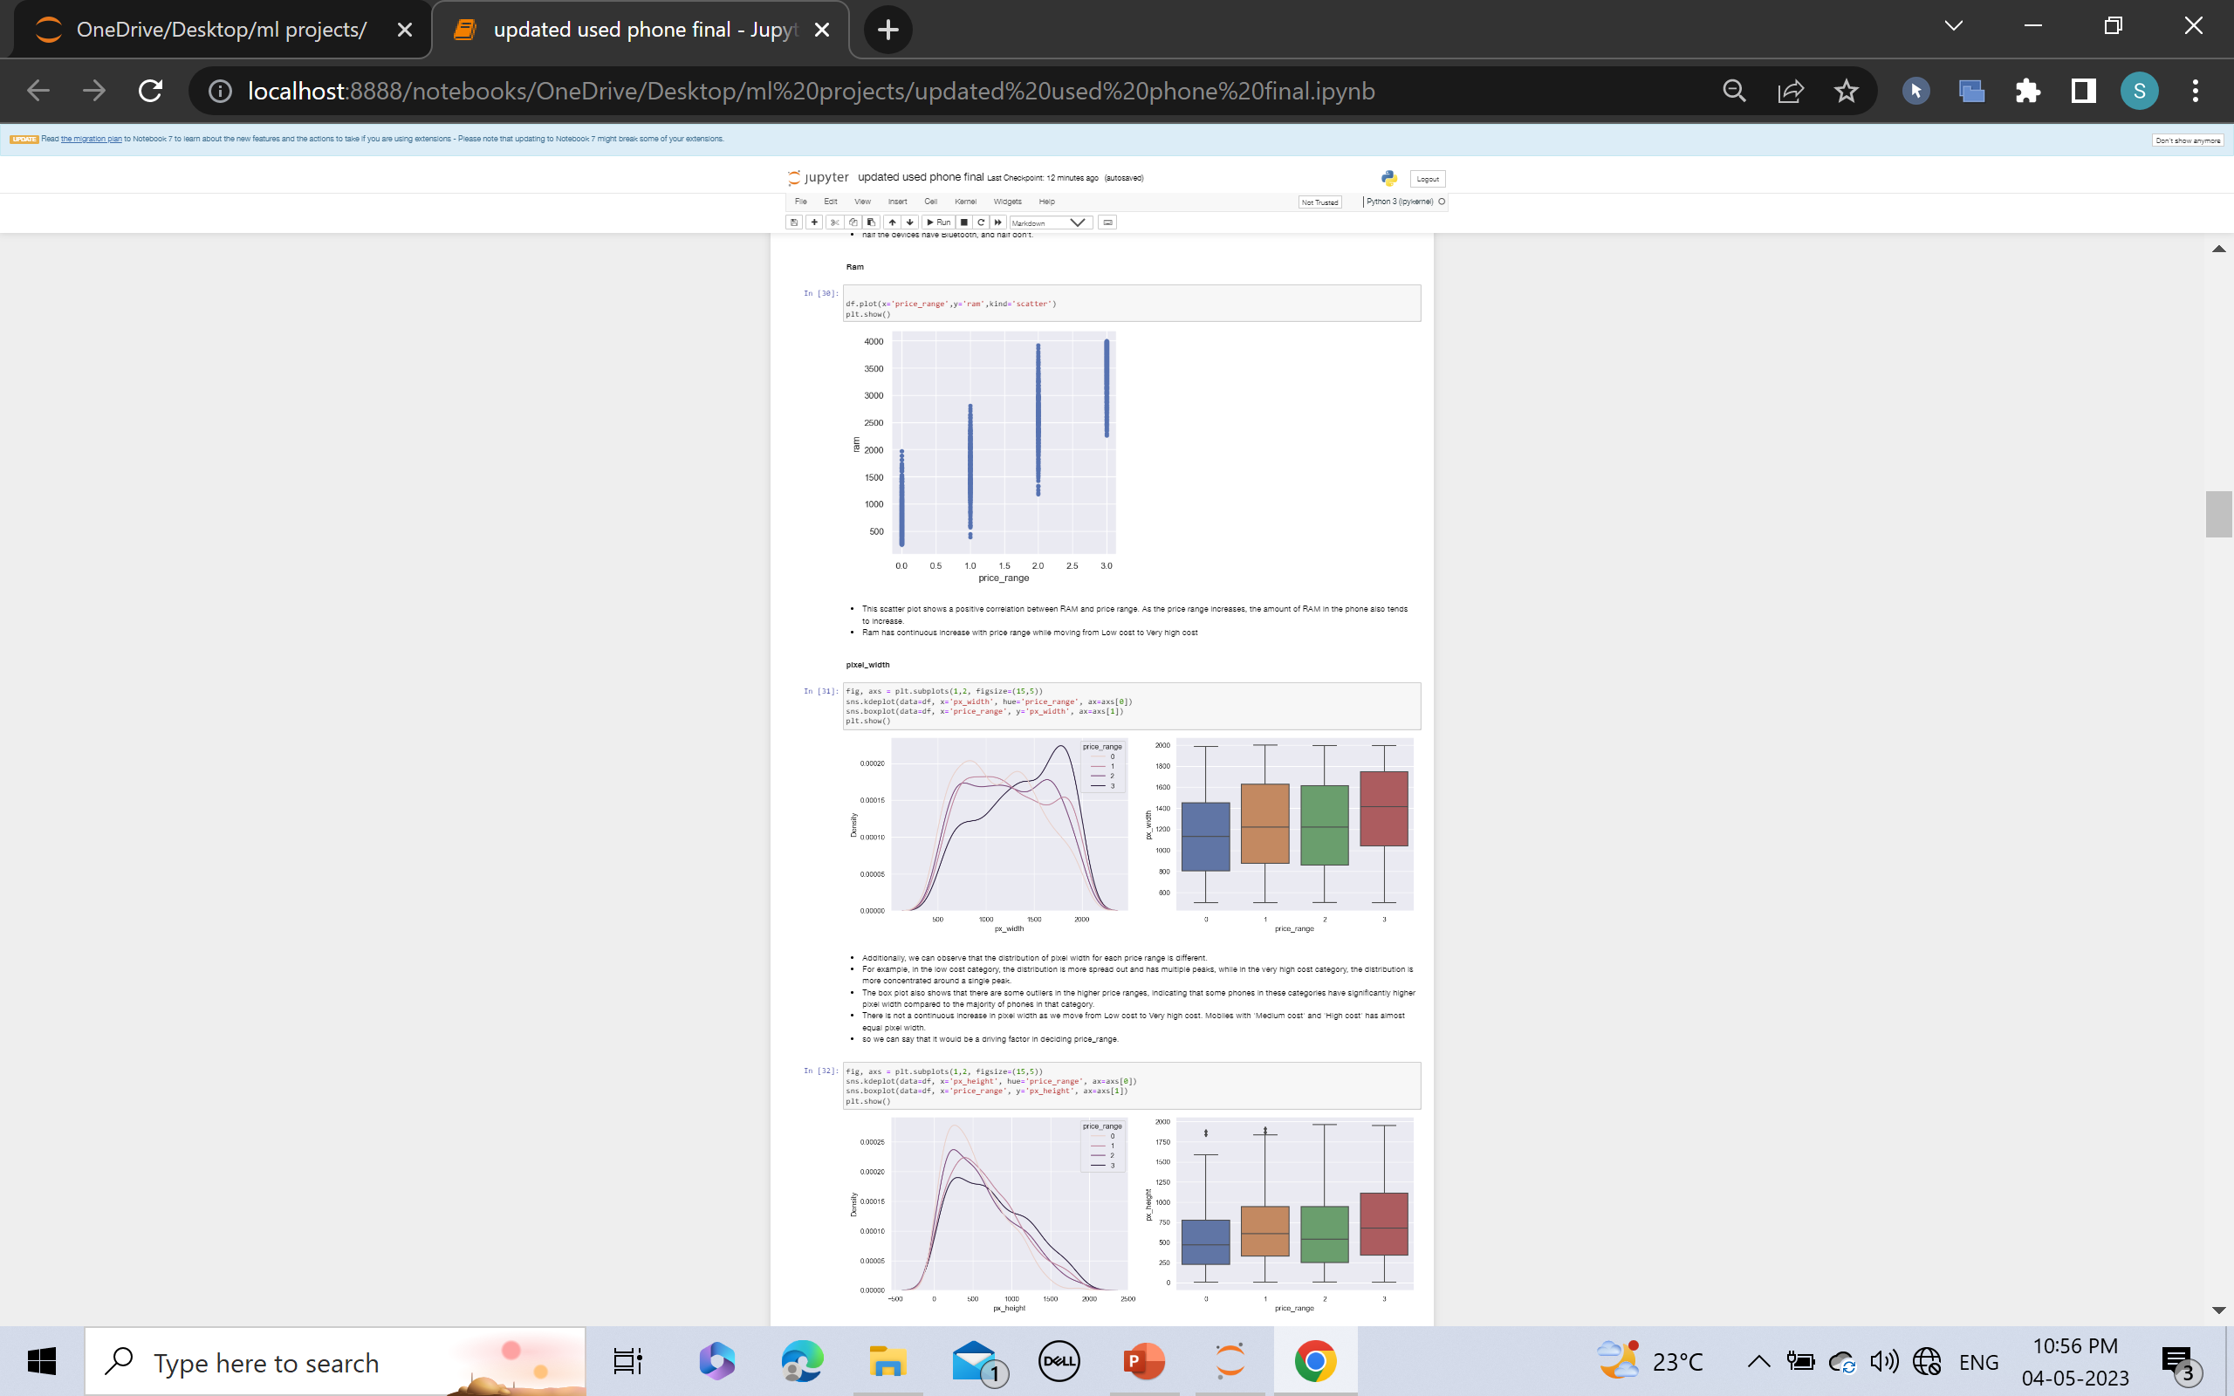
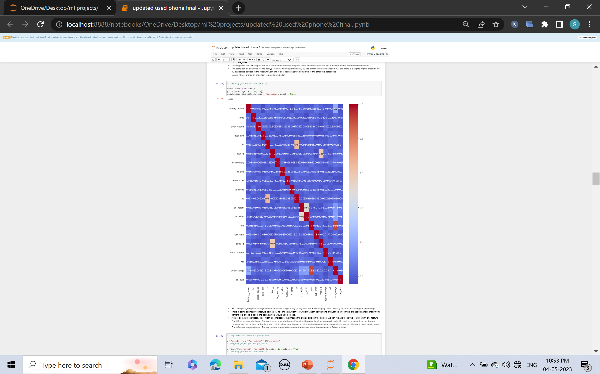
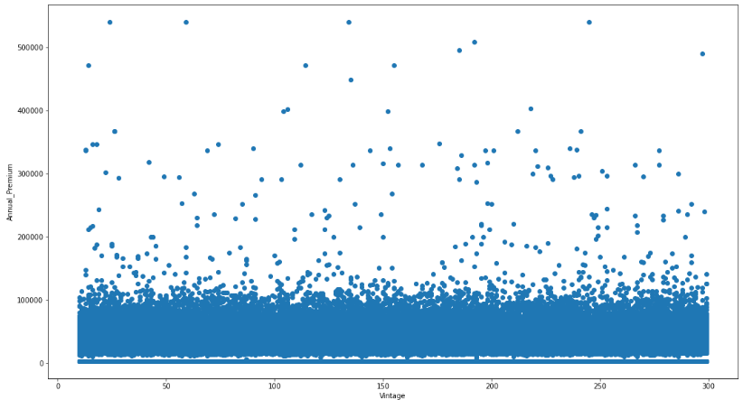
02
Visualisations

Slide 5






Machine Learning Models
Decision Tree
supervised Regression, Classification
Logistic Regression
Supervised Regression, Classification
Random Forest
Supervised Regression, Classification
03
Decision Tree is a supervised learning model that predicts the value of a target variable by learning simple decision rules inferred from the data features.
Logistic regression is a supervised learning model for binary classification problems, predicting a binary outcome based on input features.
Random forest is an ensemble learning method for classification and regression tasks that combines multiple decision trees to reduce overfitting and improve performance.

Slide 6

Decision Trees
A decision tree is a tree-like model where each node represents a feature or attribute, each branch represents a decision rule, and each leaf node represents a predicted outcome.
Random Forest
It randomly selects a subset of features and data samples to build multiple decision trees, and then averages the output of each tree to make the final prediction. This helps to reduce overfitting and improve the performance of the model.

Slide 7
Accurate ML Model
04
After performing various classification algorithms on the mobile phone price prediction dataset, we can conclude that XGBoosting gave the best results. The XGBoosting model has an accuracy score of 90% and an F1-score of 0.90, which means the model can predict the price range of mobile phones with high accuracy. Random Forest also gave a good accuracy score of 85% and an F1-score of 0.84, while Logistic Regression and Decision Tree gave slightly lower accuracy scores of around 80-85% and F1-scores of 0.80-0.85.
Therefore, XGBoosting could be used to predict the price range of mobile phones given relevant features. The accuracy of the model could be improved by gathering more data and fine-tuning hyperparameters. Our analysis can help manufacturers and customers better understand the relationship between a mobile phone's specifications and its price range.

Slide 8
Model comparisons
05
Models | Train Score | Test Score
Logistic Regression | 0.748 | 0.717
Decision Tree | 1.0 | 0.83
Random Forest | 0.998 | 0.882
XGBoost: | 0.98 | 0.90

Slide 9
06
Conclusion
The bottom line of this Project

Slide 10
Conclusion
"We analyzed a dataset of mobile phones with their specifications and prices. Through exploratory
data analysis, we discovered four price ranges with nearly equal numbers of mobile phones in each
range. XGBoosting and Random Forest with hyperparameter tuning were found to be the best models
for this dataset, with accuracy scores of 90% and 88%, respectively. RAM, battery power, and pixels
played significant roles in deciding the price range of mobile phones, while costly phones tended to be
lighter. Our analysis can help manufacturers and customers better understand the relationship
between a mobile phone's specifications and its price range."

Slide 11
Thank You!

